Slide 1
Internet of Things Using Node-Red and Alexa
AnOJA rajalakshmi
School of engineering

Slide 2
What is IoT?
Internet of Things (IoT) means learning and interacting with millions of things including services, sensors, actuators, and many other objects on the Internet.
IoT allows objects to be sensed and controlled remotely across networks.
Notes:
Things are wide variety of devices like Wifi connected or has access to internet

Slide 3
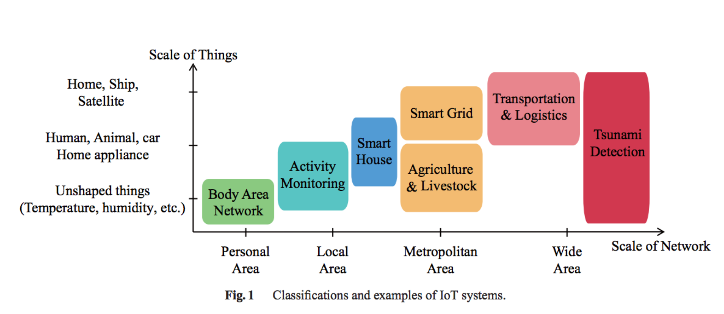
IoT Classification
Image Courtesy: Yuichi Kawamoto, Hiroki Nishiyama, Nei Kato, Naoko Yoshimura, and Shinichi Yamamoto, "Internet of Things (IoT): Present State and Future Prospects", IEICE Transactions on Information and Systems, vol. E97-D, no. 10, pp. 2568-2575, Oct. 2014

Slide 4
Evolution of Human Machine Interaction
1. Screen and Keyboard, Text-bases UI computers.
Notes:
Through monitors, people can read the outputs from computers.
The input is captured by keyboards, which is the only way.
And the “Computers” act in the middle to carry out calculation or simply do the tasks given

Slide 5
2. Mouse, GUI computers
Notes:
A computer mouse is a pointing device (hand control) that detects two-dimensional motion relative to a surface. This motion is typically translated into the motion of a pointer on a display, which allows a smooth control of the graphical user interface.

Slide 6
3. Touch Screen, Portable devices.
Notes:
A touchscreen is an input and output device normally layered on the top of an electronic visual display of an information processing system. A user can give input or control the information processing system through simple or multi-touch gestures by touching the screen with a special stylus and/or one or more fingers

Slide 7
4. Voice-control
Notes:
Voice control on smart phones: Siri, Cortana
Google home: Hands-free help from the Google Assistant
Amazon Voice service called Alexa inside Echo, Echo Dot,

Slide 8
Applications of Voice Control and IoT
Control of Home devices
Outdoor
Security
Weather Monitoring
Navigation
Industrial automation
Notes:
We can create customized skills or voice commands which can be used in day today basic

Slide 9
Basic Examples
Alexa, What is the weather today?
Alexa, trigger find my phone
Alexa, open project demo
Notes:
Project Demo: The project aims to control and automate devices using voice. The major advantage of the system is ease of management for the user by not to have his or her phone open and click on certain options to control things or go near the switch to turn it on.

Slide 10
Lets get into the project
Hardware:
MCUs: Raspberry Pi, Intel Edison, ESP8266, ESP32
Sensors: Photo Light Sensor, DHT11(Temp/Humidity), PIR, Door Sensor, Seed groove kit
Actuators: Servo Motor, LED, Relays, Buzzer
Voice: Amazon Echo
Web Services:
Alexa Skill Kit
Amazon Web Services(AWS)
IBM Bluemix
Twilio
Third party services: Open weather, Google account for email, Mosquitto

